Slide 1
Quick Tour of Blackboard Collaborate
Video Chats

Slide 2



Click on the Blackboard Collaborate link in the left-hand menu:
Then click here to see the list of class meetings:

Slide 3

Click on the meeting for the correct date. It will become available 15 minutes before the scheduled start time:

Slide 4
Open the drop-down menu to access recordings of previous classes:
Click here to open the menu:
Click here to access the recordings:

Slide 5
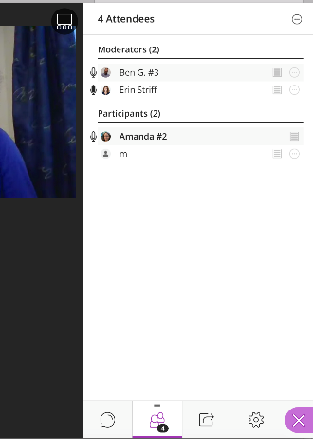
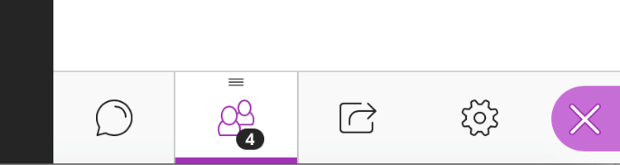





Once you’re in a meeting, you should see a panel on the right:
List of participants in the meeting
Click here to open the panel if you don’t see it yet
Click here for the participant list
Click here for the chat window
Click here for audio/video settings

Slide 6
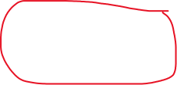



Click the settings icon if you need to adjust your microphone or speakers:
Click here to take or upload a profile picture:

Slide 7



To ask a question, type it in the chat window:
This means everyone in the class can see your message.
To send me a private message, click here:

Slide 8

You should see several icons at the bottom of the screen:
This shows that you’re connected
This shows that you’re not muted
This shows that you’re on video
This “raises your hand” so I know to call on you
Please leave your camera off for now; this will help reduce the bandwidth needed for the meeting
Please leave your microphone muted (unless I call on you) to reduce feedback and background noise
Your mic
muted
Your camera off
Your hand raised

Slide 9

Click your picture to give feedback:

Slide 10



Click the view button to switch between group view and speaker view:
Group view (everyone is equal size):
Speaker view (whoever is speaking is largest):
👩
👨
👨
👩
👩
👩

