Slide 1
FINDING
MATERIALS AND ACTIVITIES FOR ONLINE INSTRUCTION WEEK 2
Rich & Engaging
©2017
Notes:
…Today, we’ll finish our conversation about the planning and developing stage and begin talking about the creating stage. For those of you just joining us today, please know that we are using practice courses for much of the hands-on component…you should see a practice course listed when you log into your Blackboard accounts. There is a second additional course listed, Preparing to Teach Online, which you are a student in. This is a resource course and you’ll find many materials (including this PowerPoint) that will be helpful to you as you begin to design your online courses. As an FYI, we’re creating Winter Blackboard courses this week.

Slide 2
OPEN EDUCATION MOVEMENT
What are Open Educational Resources (OER)?
Open educational resources (OER) are free and openly licensed educational materials that can be used for teaching, learning, research, and other purposes.
Open Education "...is the simple and powerful idea that the world’s knowledge is a public good and that technology in general and the Web in particular provide an extraordinary opportunity for everyone to share, use, and reuse knowledge.“
"OER are teaching, learning, and research resources that reside in the public domain or have been released under an intellectual property license that permits their free use and re-purposing by others. Open educational resources include full courses, course materials, modules, textbooks, streaming videos, tests, software, and any other tools, materials, or techniques used to support access to knowledge." —The William and Flora Hewlett Foundation
Notes:
Open source is a growing movement…full courses or course materials that are not in a repository --- Anybody use open source books? Slideshare?

Slide 3
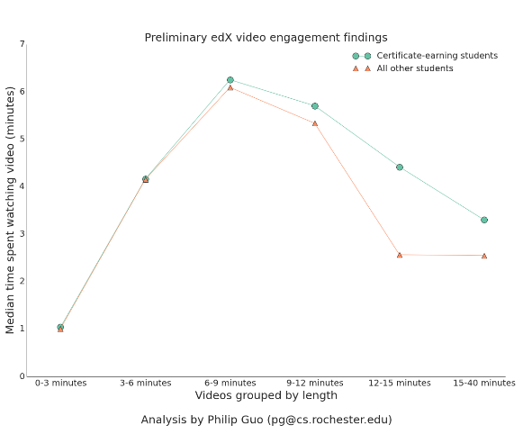
FIRST…A CAUTION ABOUT VIDEOS
6-12 minutes is the magic number
edX blog, Optimal Video Length for Student Engagement by Philip Guo (Nov 13 2013)

Slide 4
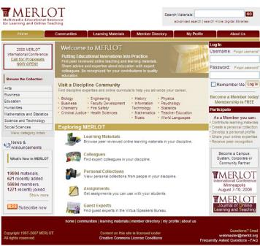
COURSE CONTENT: DIGITAL REPOSITORIES
Merlot - collection of digital learning objects
Peer-reviewed
Searchable
Discipline-specific
University of
Central Florida
Online Repository
https://topr.online.ucf.edu/
http://www.merlot.org
Notes:
Merlot is one of the earliest and is peer-reviewed, discipline specific.

Slide 5
COURSE CONTENT: MOBILE KITS
Science and Engineering
Notes:
https://www.youtube.com/watch?v=jhA0gnTO4-w

Slide 6
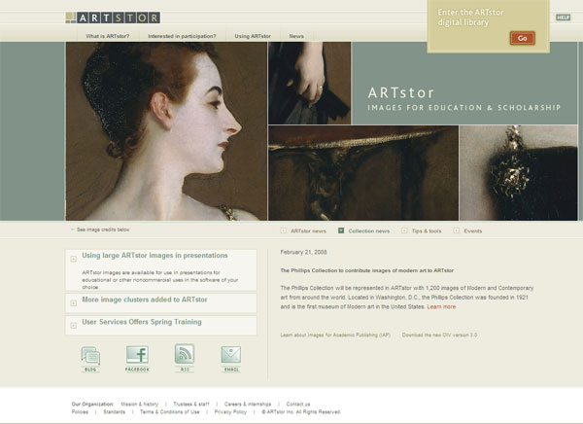
COURSE CONTENT: ONLINE LIBRARIES
ARTStor online
database of images
Includes photos,
Illustrations, and
art images
Access through
Library databases
Look under
Art & Architecture
Notes:
…but within our library, you might find materials you can use…for example ArtSTOR.

Slide 7
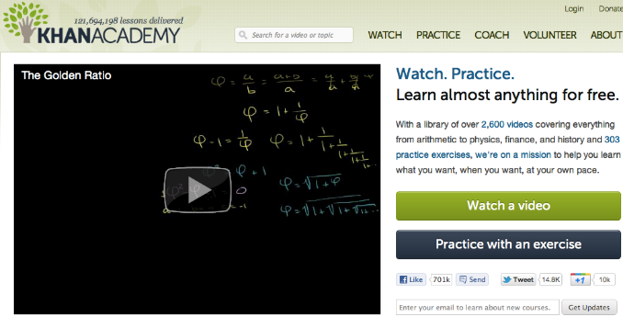
COURSE CONTENT: KHAN ACADEMY
Video tutorials and lessons…some examples
Biology Art History
Accounting Music
Booleans Engineering
Notes:
You don’t have to build it yourself…there’s so much out there!

Slide 8
COURSE CONTENT: YOUTUBE
Notes:
Libraries goes without saying…

Slide 9
COURSE CONTENT: PRIMARY SOURCE MANUSCRIPTS
British Library

Slide 10
COURSE CONTENT: PRIMARY SOURCE VIDEOS
Robert Frost Reading Mending Wall

Slide 11
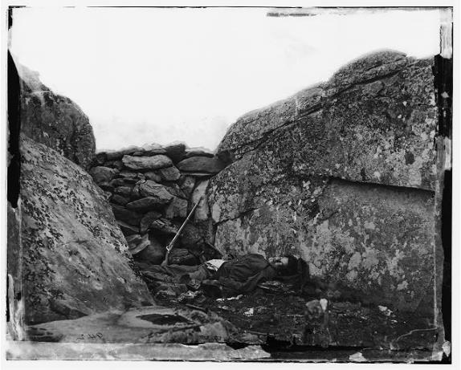
COURSE CONTENT: GOVERNMENT RESOURCES
Library of Congress
National Archives
Smithsonian
Digital Jukebox
https://learninglab.si.edu/
Notes:
As you know, anything the government made is freely available. Check out those resources. Have been digitizing like crazy.

Slide 12
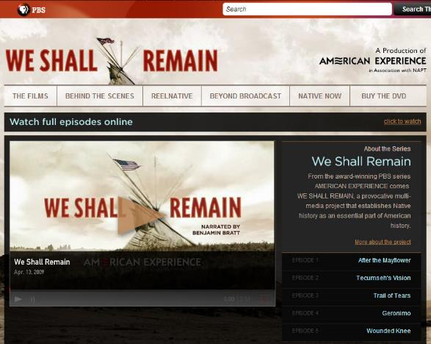
COURSE CONTENT: VIDEOS
Public Broadcasting Service (PBS)
Notes:
YouTube is only one place to find videos. PBS often has good quality videos you can link to…but other sites as well.

Slide 13
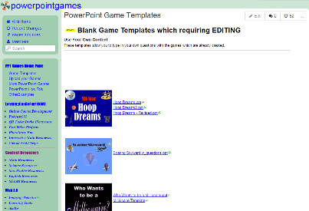
COURSE CONTENT: TEMPLATES
Powerpointgames– free PowerPoint templates
https://sites.google.com/a/uww.edu/jonesd/home/games/
http://powerpointgames.wikispaces.com/PowerPoint+Game+Templates
Notes:
Great site for creating all kinds of fun and engaging PowerPoints…good for practice, reinforcement of concepts, facts. They provide templates, you just edit the words.

Slide 14
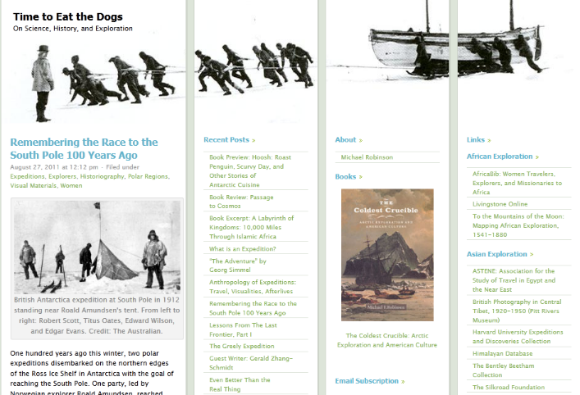
COURSE CONTENT: BLOGS
Hillyer College’s Michael Robinson’s Time to Eat the Dogs
Notes:
Blogs can be either content or practice (make your own blog). Michael Robinson is a Professor of History in Hillyer College. This is his blog…

Slide 15
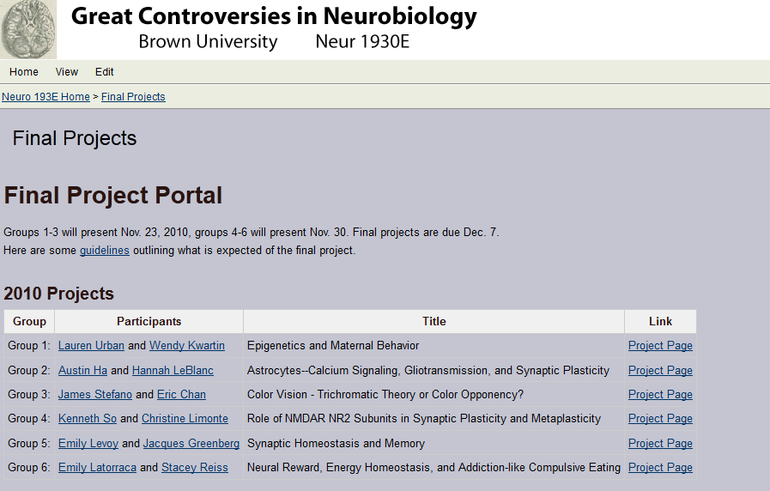
CREATE YOUR OWN COURSE CONTENT: WIKIS Blackboard (private) Wikispaces, PBWiki (public)
Example: Brown University Group Project Wiki
Notes:
Wikis can be used for group projects…you can see individual member’s contributions, as well as the final project. Wikis will help build in interaction and teambuilding.

Slide 16
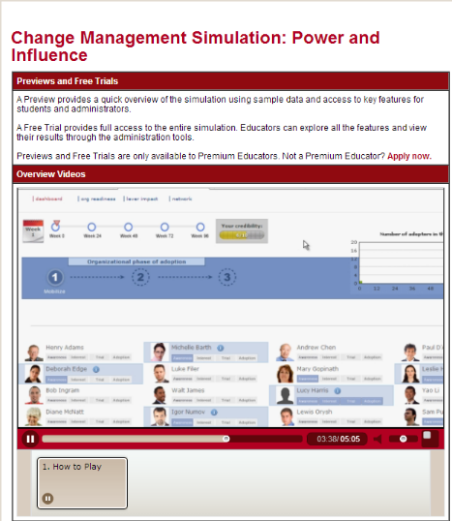
COURSE CONTENT: PUBLISHERS
Follet
Pearson
McGraw Hill
Cengage
Wiley
Harvard
Notes:
For basic content, you might check with the publishers…they offer etexts, but also lots of highly engaging, interactive content for practice and assessment. Caution however, that some of these are ‘out of the box’ courses…editing them may not be the best. As of this spring, we have direct connections for McGraw and Pearson from Blackboard…appears seamless to student. Connects publisher grades to Blackboard grade center.

Slide 17
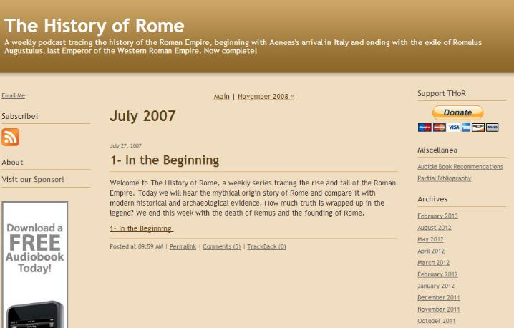
COURSE CONTENT: PODCASTS
Example: History of Rome Podcast by Mike Duncan
Notes:
Podcasts can be very informative…this is an example of one, by Mike Duncan, is on the history of Rome.

Slide 18
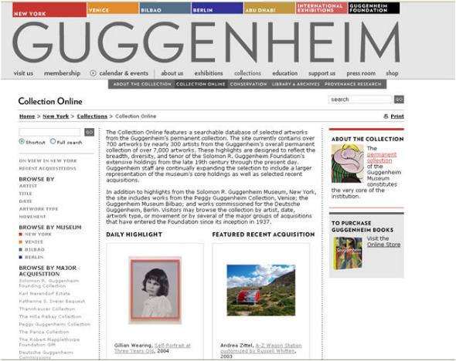
COURSE CONTENT: MUSEUMS
Guggenheim Online: https://www.guggenheim.org
Notes:
Museums…again, digitizing as much as they can.

Slide 19
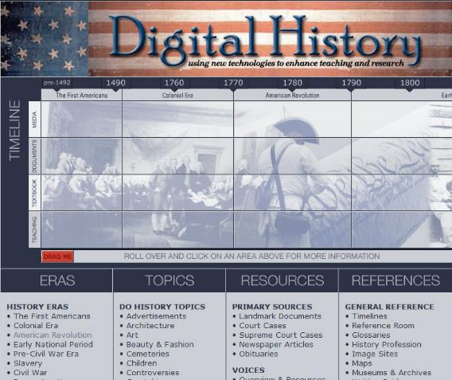
COURSE CONTENT: INTERACTIVE SITES
Example: University of Houston Digital History Site
Notes:
Google interactive ________ (your discipline) to find all sorts of interactive websites.

Slide 20
COURSE CONTENT: SPEAKERS
Ted Talks
Notes:
Fabulous site…chalk full of great speakers of the day. Keynote type speakers. Great supplemental resources. Search Dave Eggers…

Slide 21
“LESSONS WORTH SHARING”

Slide 22
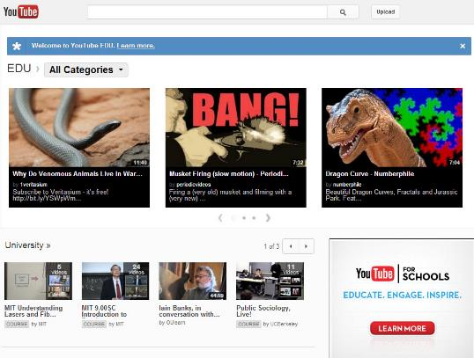
COURSE CONTENT: YOUTUBE’S EDU
If you want to learn how blogs, wikis and RSS feeds work, check out YouTube’s In Plain English. Consider sharing them with your students so they can learn too…
Notes:
YouTube good for concepts or primary source materials. There is a YouTube channel specific for educators in YouTube.

Slide 23
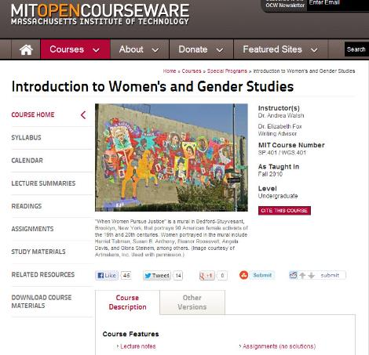
COURSE CONTENT: OPEN SOURCE
MIT Open Courseware Initiative
Internet Archives
GoogleBooks
ITunes U
Creative Commons
Slideshare
Notes:
Open source is a growing movement…full courses or course materials that are not in a repository --- Anybody use open source books? Slideshare?

Slide 24
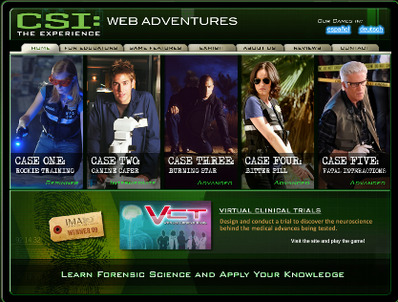
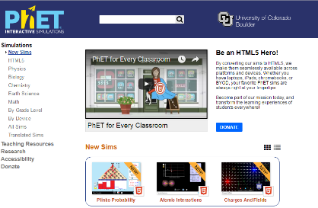
SIMULATIONS / GAMES
CSI: The Experience Web Adventures http://forensics.rice.edu
PhET Interactive Simulations
https://phet.Colorado.edu/en/simulations/category/new
Notes:
Simulations and Online Games are wonderful ways to engage your students that are fun and give students practical hands-on, applied experience.

Slide 25
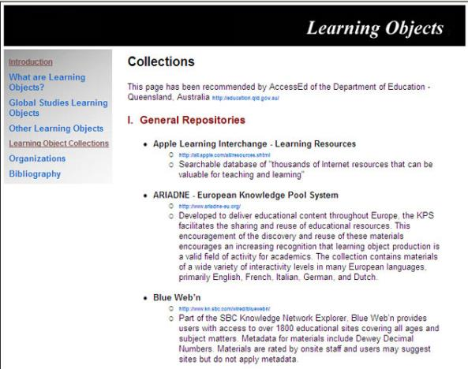
COURSE CONTENT: DIGITAL REPOSITORIES
Google for
lists of digital
repositories
Many topics/types
Notes:
There are freely available shared digital content in repositories. Some are interactive labs, some are flashcards, some are case studies. All freely shared. If you click on the link here, it will bring up a list…

Slide 26
COURSE CONTENT: DIGITAL REPOSITORIES
University of Central
Florida
Teaching Online Pedagogical Repository
Notes:
There are freely available shared digital content in repositories. Some are interactive labs, some are flashcards, some are case studies. All freely shared. If you click on the link here, it will bring up a list…

